Slide 1
UP THE LADDER
CS-301
Rahul Poddar (U101116FCS097) S-4
Piyush Singhania (U101116FCS282) S-4
Anubhav Paul (U101116FCS012) S-1
Jatin Gupta (U101116FCS052) S-3

Slide 2
Project Description
Up The Ladder is a unique platform for enthusiastic undergraduates and working professionals. The vision is to help everyone grow into whatever they want to be, the idea is to help people answer the question “Where do you see yourself in the next 5 years?”. Up The Ladder, unlike any other career growth support platforms provide the user a customized roadmap to their dream profession irrespective of which discipline a user might belong to. No existing platform allows the user to set their goal and help them reach it starting from scratch, all existing platforms come with a set of pre-requisites which are expected to be fulfilled by the user however the main issue being no instructions are provided as to how one is expected to fit perfectly into the list of prerequisites.

Slide 3


Project Description
The idea for Up The Ladder came from the modern day plight of skill development and lack of a robust roadmap which would instruct and depict the stages. The idea is to further widen the base of education and encourage the enthusiasts to reach expertise in fields of their choice. Up The Ladder unlike any other platform creates a custom roadmap so user friendly that even a layman with a knack in learning can use it to gain expertise in a field of choice.

Slide 4
Potential Customers
1. Self-employed persons looking to elevate their enterprise to the next level.
2. Full-time and part time employees seeking the right path for them and their careers.
3. Freelancers and independent contractors looking to make a switch in their careers.
4. Undergraduate and Post-Graduate students seeking counsel and advice for their careers.
5. Parents looking for career guidance for their respective children/wards.
6. Companies who are looking to carry out training programs for their employees.

Slide 5
Novelty and Creation of Value
True, there already exist a wide variety of promising career development tools in the market but while they serve different purposes and full well in most cases, they all fail to deliver at one standpoint: Helping people make an informed decision.
Creation of Value: 1. With India’s growing active and participating workforce in technical, semi-technical, business and humanities fields, there is an increasing need to build a smart tool connecting industry enthusiasts with industry experts. We have created value by creating a unique platform by providing our customers with detailed career development progression in various fields - encompassing what the career stream entails, skills (technical and soft) required to become an expert, competitive exams required, educational skills required, average salaries for different positions and future of career stream.

Slide 6
Novelty and Creation of Value
2. Our service is the first platform that serves as a one-stop shop for students, teachers, budding entrepreneurs, existing independent contractors and employees to discover the different financial, social and personal features of industries, recent trends and career development. Unlike LinkedIn and other career development services, Up the Ladder will hope to be India’s most informative career development tool.
3. We believe one of our biggest selling points is that we cater to people of all ages, occupations, interests and motives. While other career development tools focus on just a particular particular strata of customers and professionals, our service can be used not only for career planning (for working people) but also for educational (for students) and research purposes (technicians and engineers).

Slide 7
Sophistication Value of Project
It requires an upfront investment of time and effort: During the early phases we had to devote a huge amount of time developing and nurturing the idea. It also took us a lot of time to verify our idea and to find its potential in real time. Since this project had to be completed simultaneously with other projects, it required dedicated time and effort from all the team members.
You don't have the right skills: Learning the tools and different coding languages in a given stipulated time was a very difficult job.Understanding the concepts of coding metrics,sequence diagram,use case diagram,etc and developing those diagrams using online tools like creately,lucidchart required a lot of efforts. In the process, we also had to acquaint ourselves with tools like LucidChart, Draw, Creately, etc. which was a challenge in itself.

Slide 8
Sophistication Value of Project
Some people think that the project idea is vague: The value is in the disciplined utilization of sound, consistent processes. In our case, on the onset, Up the Ladder looks similar to LinkedIn in terms of working and application. However, not only does it do what LinkedIn does but it also provides an integrated career development platform for industry experts and enthusiasts alike.
The business environment changes as you work: The realities of global competition and rapid technological change are particularly visible in IT and software development. This contributes to the volatility of our project’s goals and operating constraints. Everything can be made obsolete in an instant — and it’s hard to pivot late in the process. Keeping this in mind, we will have real time assessment of the market and accordingly we will be changing the information present on our website to avoid misleading our users.

Slide 9
Sophistication Value of Project
The problem and solution are often not well understood: When a solution to a problem was well understood, it got captured in a framework.It got hard when the focus shifted to create more complex, less well-understood things using common tools.
The problem that we face with a growing economy is that there are too many students, job aspirants and even working employees who do/did not have enough information about the job market, work environment, salary package and future of career stream to make an informed decision. Up the Ladder solves this problem by providing a complete package covering what the career stream entails, skills (technical and soft) required to become an expert, competitive exams required, educational skills required, average salaries for different positions and future of career stream.

Slide 10

Customer Scenarios
Scenario 1 An undergraduate in Computer Science in her 1st semester wants to become a cyber security expert but has no clue as to how to go about it. Any online portal she visits provides her with a huge list of prerequisites which she has no clue as to how to fulfill, Up The Ladder provides instruction and course details to fulfill the prerequisites and then provides further details and approaches to help her reach her goal as a cyber security expert.

Slide 11
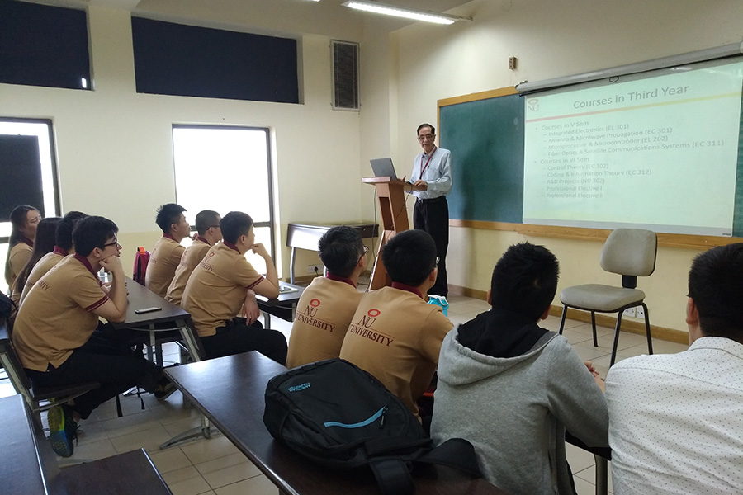
Customer Scenarios
Scenario 2 A high school teacher wants to educate the students of her class regarding the career prospects. Considering the cut-throat competition in the modern economy, it is important to enlighten the students about future jobs and give them enough information to make an informed decision. The teacher can help the students in doing so by enrolling all the students on our web app and helping them see the various career streams and everything that comes with them.

Slide 12

Customer Scenarios
Scenario 3 A recently passed out post graduate student with a degree of Business Management who has a ground-breaking idea for his startup and needs to further pursue on that idea. He/She can sign up on our web app and get all the information and resources required to run a successful start-up, ranging from courses on entrepreneurship to Human Resources Management.

Slide 13
Up the Ladder - Applications
● Typical users of the application includes school and college students, self-employed persons, company administrators and independent contractors.
● Professional/Technical Users such in different fields of Engineering, Human Resources, Psychology, Researchers who want to use Up the Ladder for more analysis of careers, persons and employment.
● Programmers who are interested in working on the project by further developing it, providing insights and fixing bugs.
Working Professionals currently experiencing stagnation in their professional careers would be the most sought after users as they will get to properly plan their career.

Slide 14
Up the Ladder - Usage of Tools (Present and Future)
Phase 1 : Initiation and Design of Project
To build our software product, we started with the architecture of the project. The architecture of the project mainly involved a Login System allowing users to advance in terms of skill in various fields of their choice.
Tools used : 1. Lucid Chart for sequence diagrams.
2. Creately for data flow diagrams and architecture diagrams.
3. Draw.io for Use Case Diagrams.
4. ERDPlus for Entity Relationship Diagram of Database Design.

Slide 15
Up the Ladder - Usage of Tools (Present and Future)
Phase 2 : Design of Front-End.
Since our product was mainly a webapp involving all the functionalities required, the design of the User Interface was a major task.Unlike other webapps, this web app has a different look and feel in each of the different pages comprised in the webapp.
Tools Used: 1. HTML and CSS for basic website design.
2. Bootstrap for advanced responsive web design.
3. Jquery.js involved also for responsive website development.
4. Fonts API was used for giving a good look and feel to the web app

Slide 16
Up the Ladder - Usage of Tools (Present and Future)
Phase 2 : Design of Front-End.
Since our product was mainly a webapp involving all the functionalities required, the design of the User Interface was a major task.Unlike other webapps, this web app has a different look and feel in each of the different pages comprised in the webapp.
Tools Used: 1. HTML and CSS for basic website design.
2. Bootstrap for advanced responsive web design.
3. Jquery.js involved also for responsive website development.
4. Fonts API was used for giving a good look and feel to the web app

Slide 17
Up the Ladder - Usage of Tools (Present and Future)
Phase 3: Backend functionality of a full fledged working app.
After building our interactive User Interface and a review from our clients , we started off with our backend functionalities for the app to function properly.
Tools Used : 1. MySQL for database of the web app.
2. PHP for the backend functionalities of the app.
3. Visual Studio Code for the coding of the entire app.
4. Xampp for Apache Server and Database Management.

Slide 18
Minutes of Meeting (MoM)
Firstly, it is to be noted that we are providing a mass service/platform and we do not have one defined customer or customer segment. Therefore, it is impossible to get Minutes of Meeting from our users. However, we’ll be requiring information from a varied set of professionals pertaining to different career streams. In the process of building Up the Ladder, we got in formal agreement with executives and individuals from many companies and firms, on mail, in office or both.

Slide 19
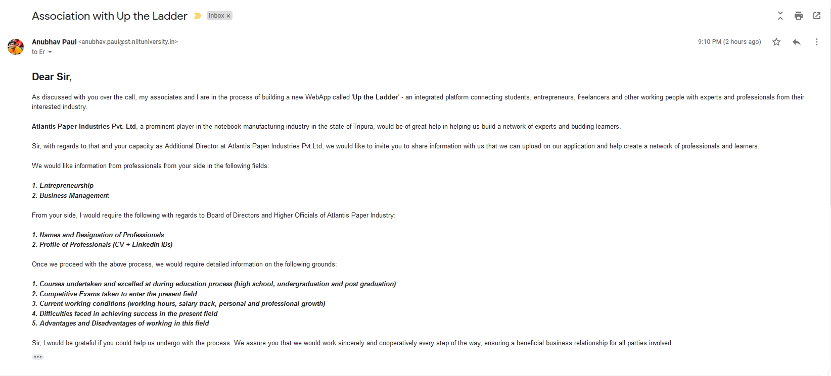
Atlantis Paper Industries Pvt. Ltd. (Mr. Sanjit Paul)

Slide 20
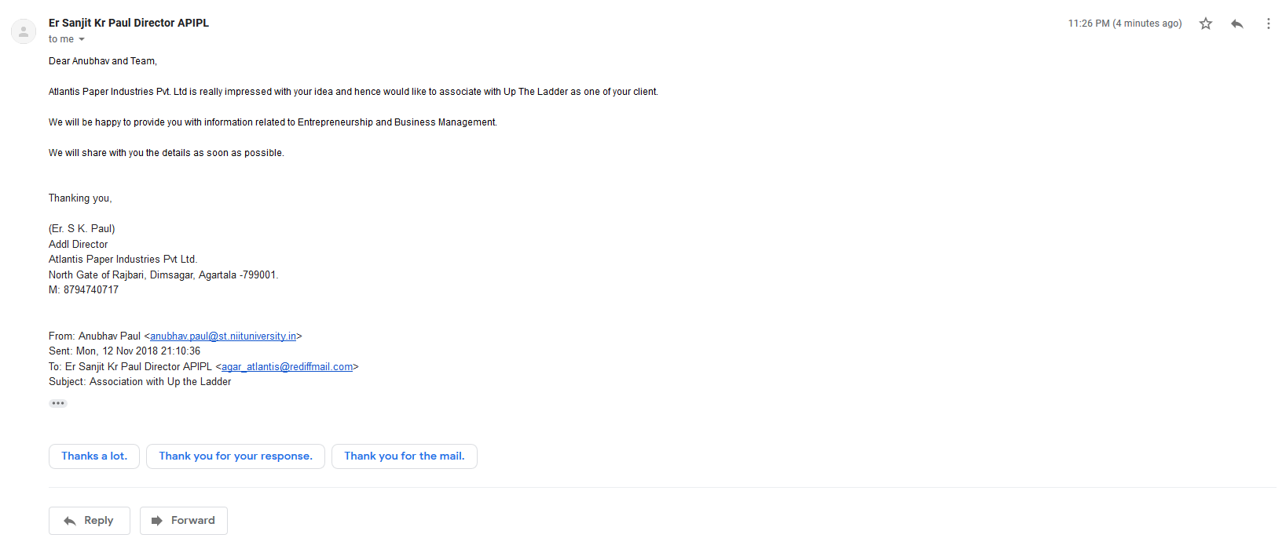

Slide 21
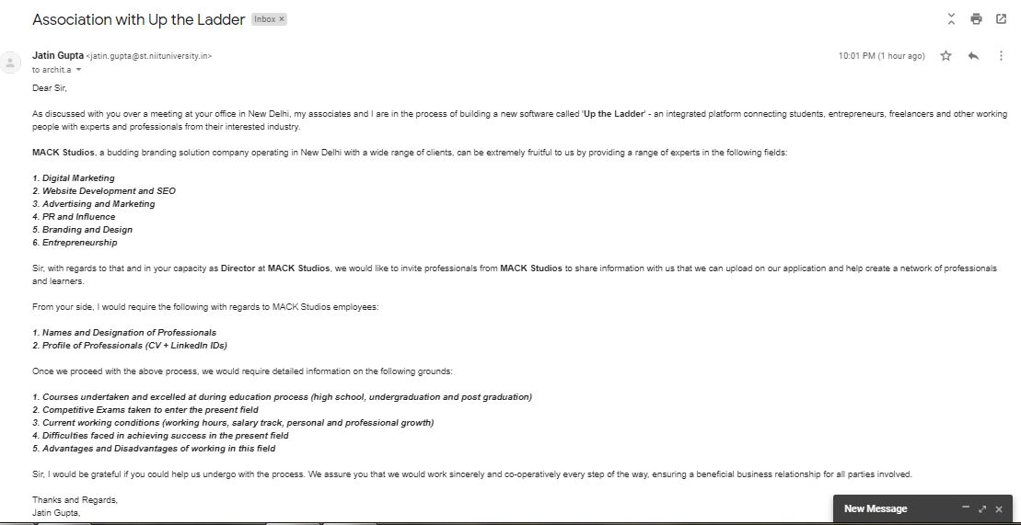
MACK Studios (Mr. Archit Aggarwal)

Slide 22
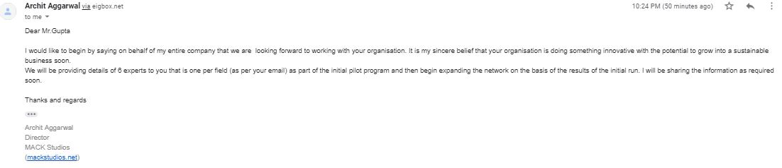

Slide 23
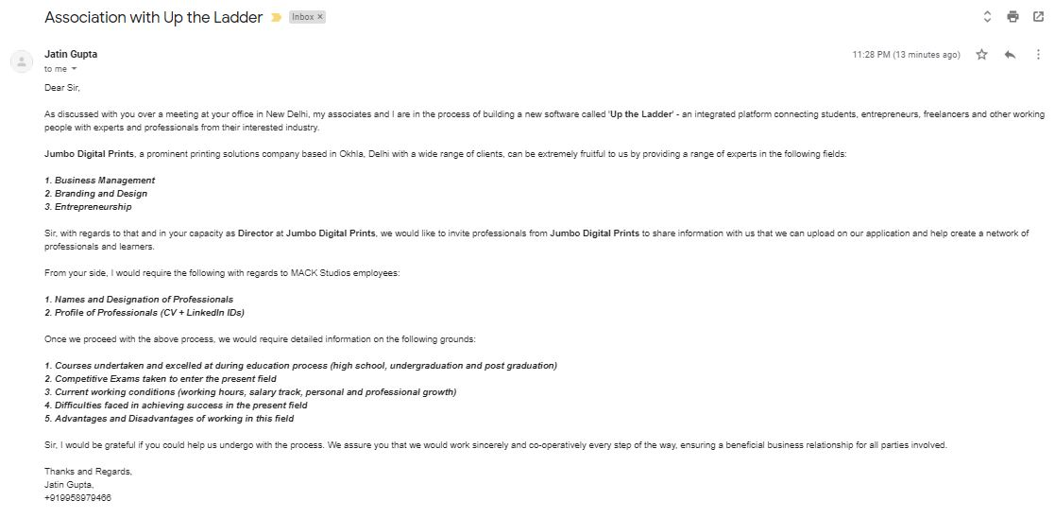
Jumbo Digital Prints Pvt. Ltd. (Mr. Umesh Gupta)

Slide 24
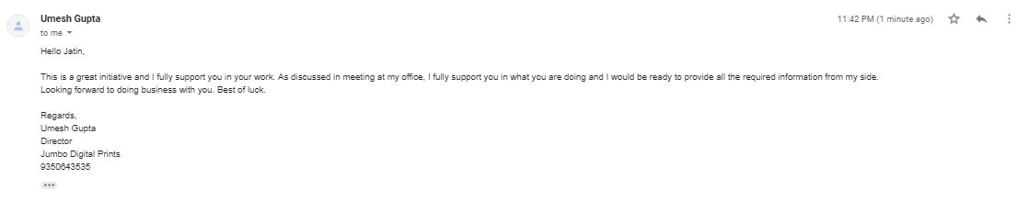

Slide 25
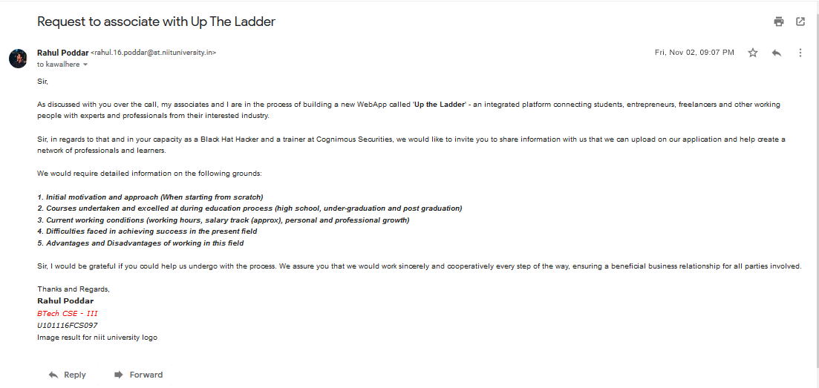
Cognimous Securities (Mr. Kawaljeet Singh)

Slide 26
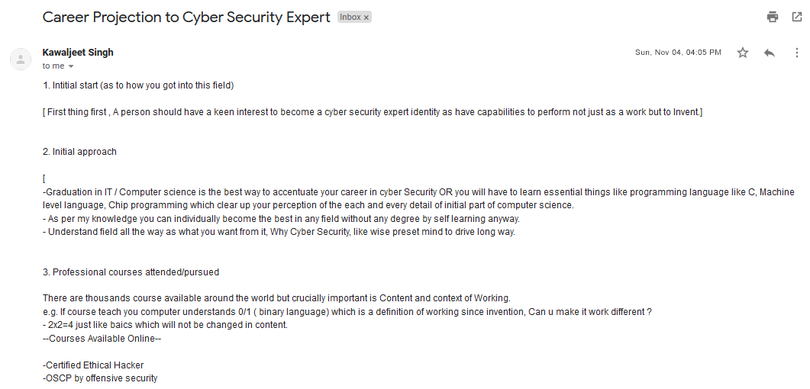

Slide 27
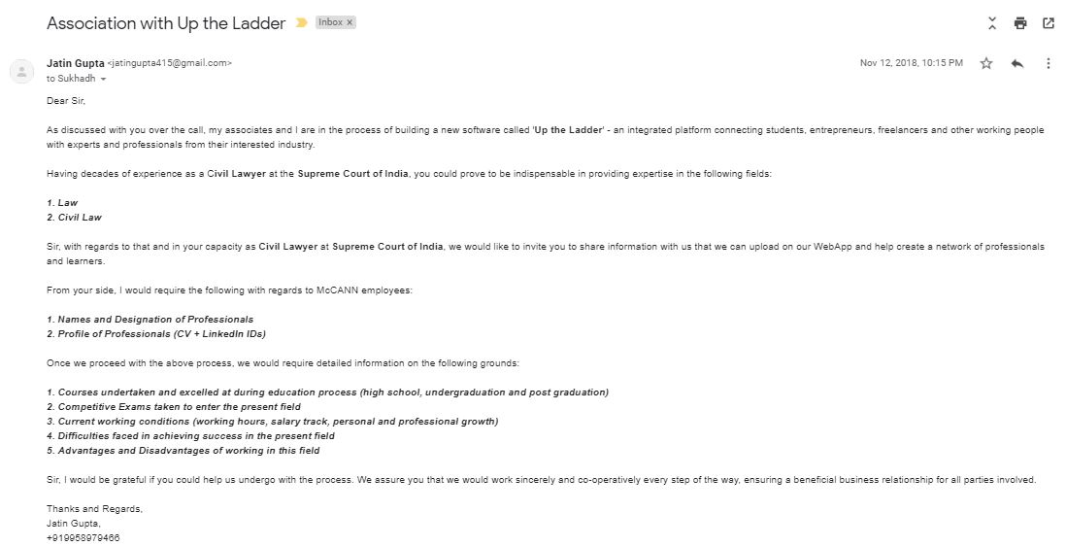
Supreme Court of India (Mr. Sunil Khatwani)

Slide 28
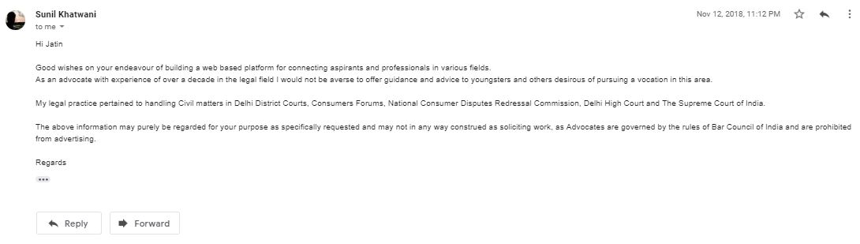

Slide 29
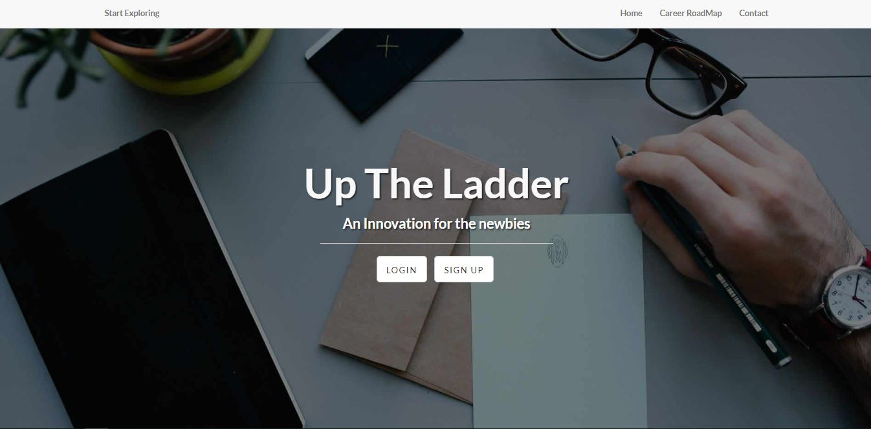
Snippets of Up the Ladder

Slide 30
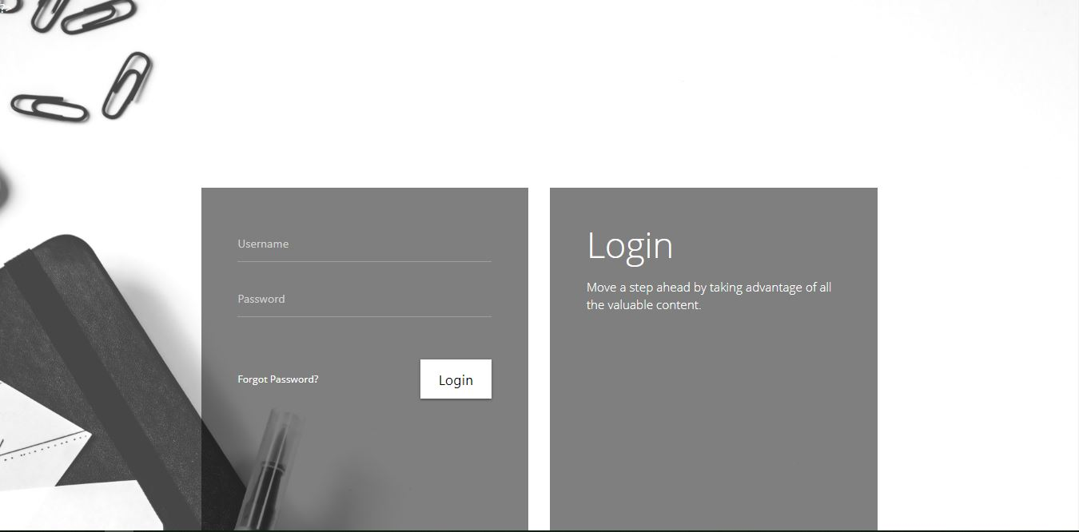

Slide 31
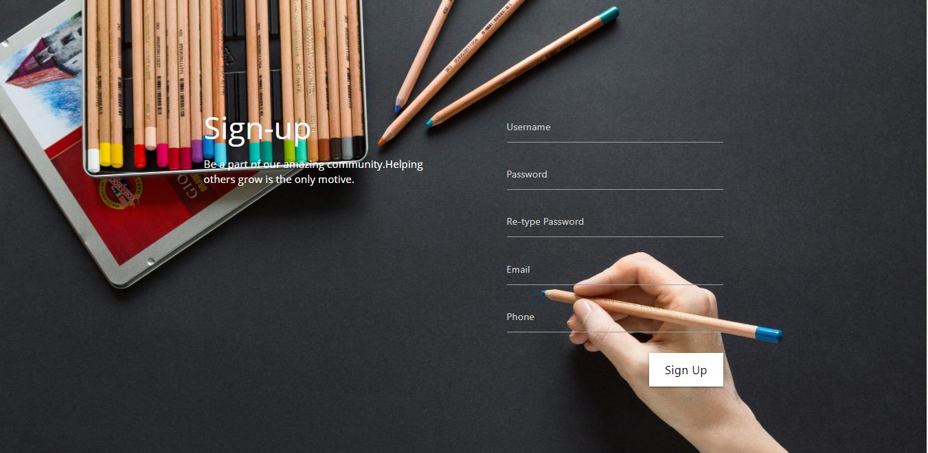

Slide 32
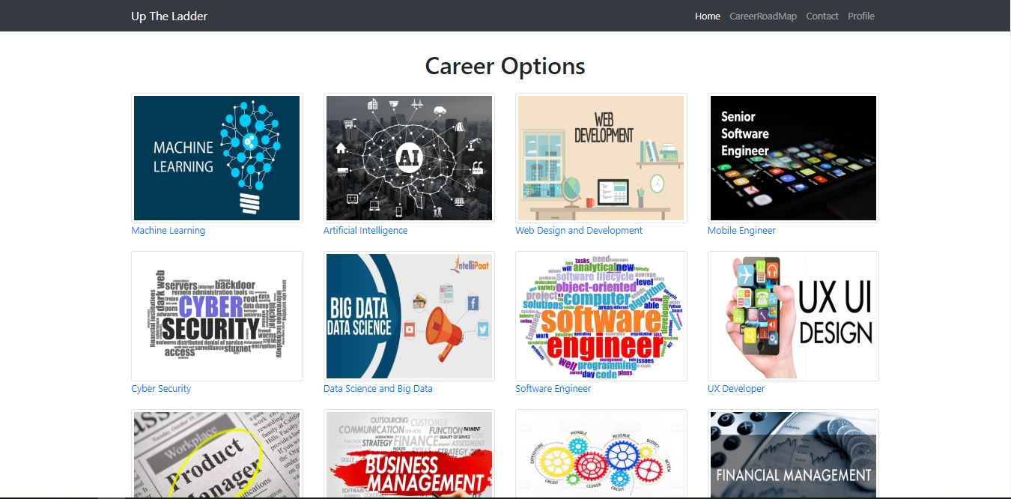

Slide 33
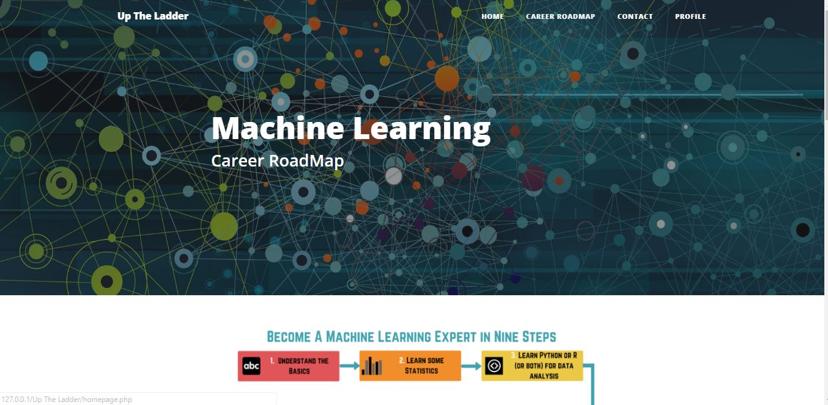

Slide 34
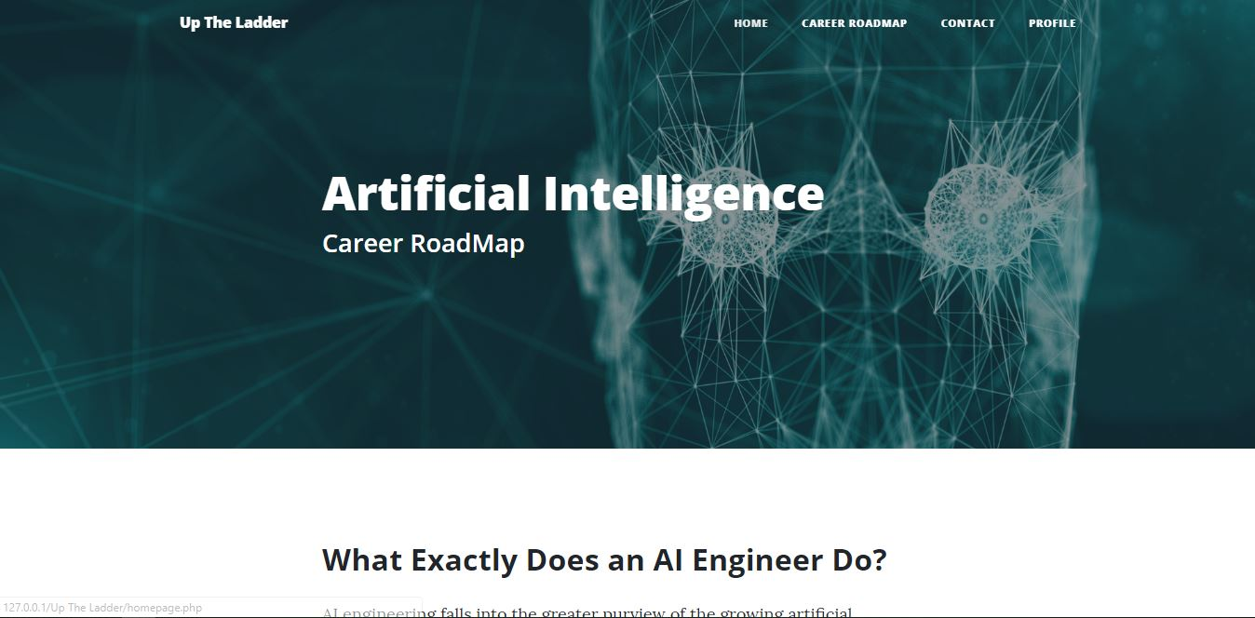

Slide 35
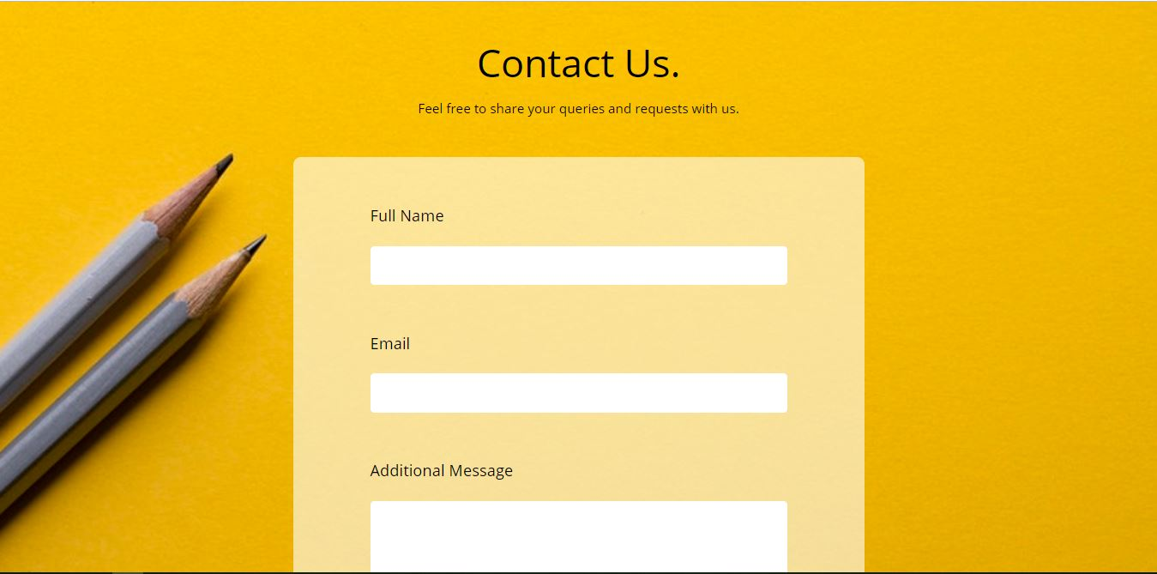

Slide 36
